Slide 1

CSE-6413
Network Science

Slide 2
Group members
ARNAB SIRCAR - 0424052036
A. S. M. Muntaheen - 0424054602

Slide 3
Project Title
Exploring Connections: A Network Analysis of Facebook's Food Pages

Slide 4
Introduction
This project analyzes the "Facebook Food Pages" network, focusing on identifying influential pages, uncovering communities, and assessing centrality. By examining mutual likes between pages, we pinpoint key influencers, reveal clusters of related pages, and gauge brand popularity within the food network. This study offers insights into social influence, community structure, and brand visibility in food-related social media

Slide 5
Literature Review
In [1], the author discusses GEMSEC, a graph embedding algorithm that simultaneously learns node embeddings and clustering.
In [2], the author leverages Node2Vec to learn high-dimensional node embeddings that capture both local and global network structures, and applies machine learning models for link prediction in social networks.

Slide 6
Dataset Overview
Data collected about Facebook pages (November 2017).
Nodes represent the pages and edges are mutual likes among them.
Food category pages

Slide 7
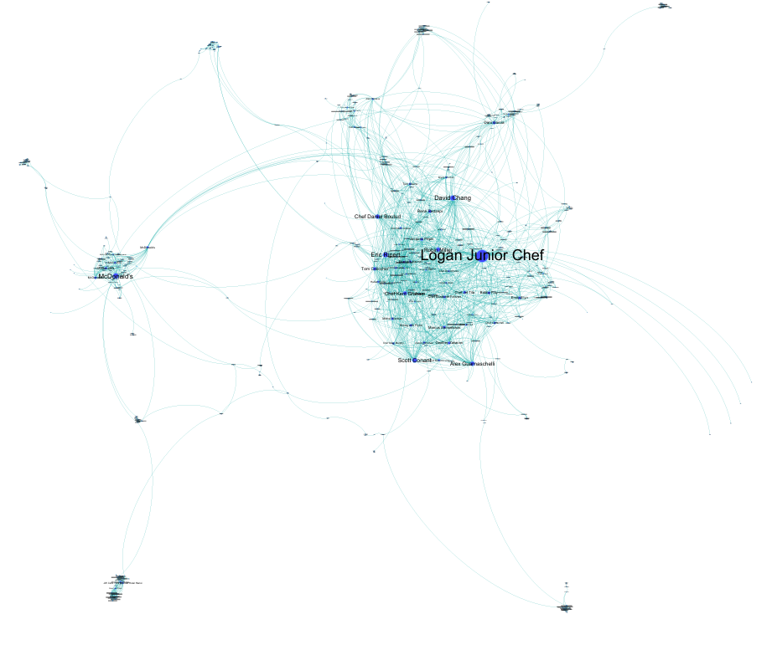
Visualisation
Number of nodes: 620
Number of links: 2102
Undirected
Unweighted
No Isolated components

Slide 8
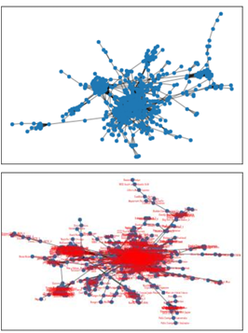
Exploration of the network
Density: 0.01
Standard deviation: 9.47
Mean: 6.78
Median: 4.0
Min: 1
Max: 134
Assortativity coefficient: - 0.028

Slide 9
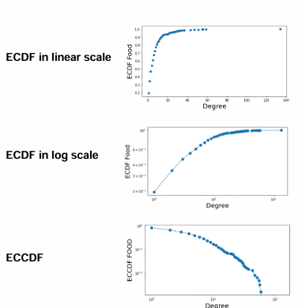
Connectivity
No Isolated components
Number of connected components is 1
The number of triangle is 8805

Slide 10
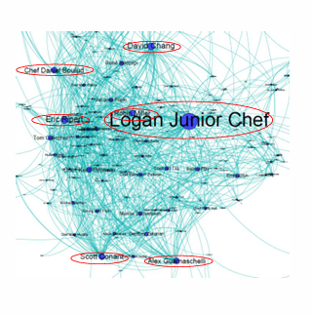
Hubs,Transitivity and Clustering
99-Percentile degree is about 47
8 nodes has a degree >= 47: 'Logan Junior Chef','Robin Miller', 'Scott Conant', "McDonald's_6", 'Eric Ripert', 'Alex Guarnaschelli', 'David Chang', 'Chef Daniel Boulud'
Transitivity value is : 0.223
Average Clustering coefficient: 0.331

Slide 11
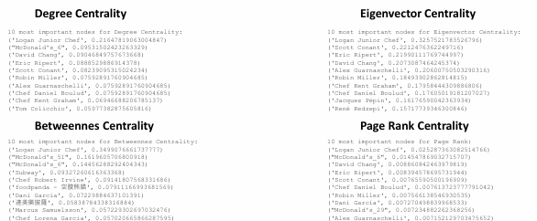
Centrality
This is based on the assumption that important nodes have many connections

Slide 12
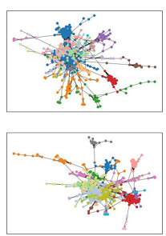
Communities
Using set of greedy partition we obtain 21 communities
Using set of Louvain partition we obtain 17 communities

Slide 13
Conclusions
No Isolated components and only one connected component
Scale-free network
8 identified major HUBS
Identified most important nodes using different Centrality methods
Identified communities

Slide 14
References
Rozemberczki, B., Davies, R., Sarkar, R. and Sutton, C., 2019, August. Gemsec: Graph embedding with self clustering. In Proceedings of the 2019 IEEE/ACM international conference on advances in social networks analysis and mining (pp. 65-72).
Balvir, S.U., Raghuwanshi, M.M. and Borkar, P.S., 2024. Node2Vec and Machine Learning: A Powerful Duo for Link Prediction in Social Network. Journal of Electrical Systems, 20(2s), pp.639-649.

Slide 15
Thank you

